Slide 1
Reframing Others in Colours of Mastery
23rd November 2017
Bjørn Z. Ekelund and Piotr Pluta, Human Factors AS
Notes:
Space left for the user to fill in [name, position, organization, address].

Slide 2
The Reframers:
Piotr Pluta, MSc in psychology,
Man. dir. Consultancy
Bjørn Z. Ekelund, psychologist, MBA, Chairman of the Board

Slide 3
Over view of presentation
Diversity Icebreaker – what is it?
Refugee and immigration relevant experiences
Refugee camps Serbia – Greece
Work-life integration with mentoring Germany
Poland: WrOpenUp project
Middle East Palestine, Jordan and Israel
Norway Fast track integration and housing projects
Practical learning
Theoretical challenges

Slide 4
Behind Diversity Icebreaker
The development of Diversity Icebreaker was initiated in 1995 by
Bjørn Z. Ekelund, Psychologist, MBA, CEO of Human Factors AS Norway.
An International Management Consultant company Human Factors AS was established in 1993 , specializing in teams, leadership, cultural diversity, communication, project leadership, and measurement instruments.
RED , BLUE and GREEN established as categories for communication.
Today the questionnaire is available in 19 languages + working translations

Slide 5
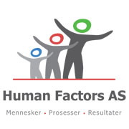
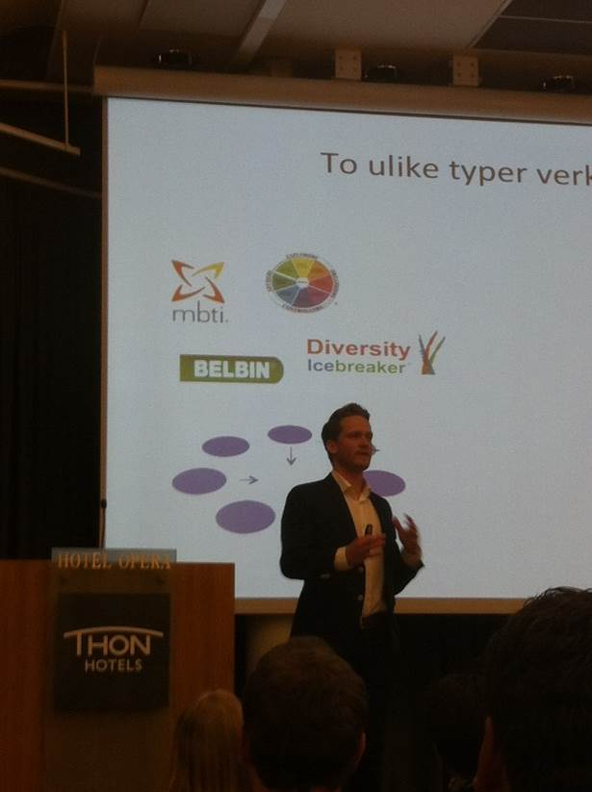
Overview of practical use of
the Diversity Icebreaker
Personal development
Communication training
In developmental programs
As kick offs in projects and large conferences
In team – and management
/ leadership development
In group / cultural conflict management
In cross-cultural management training
Learning styles
Changing organizational culture to a diversity management culture with a focus on acknowledgement and knowledge creation

Slide 6
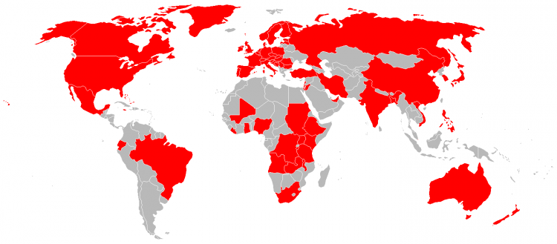
Diversity Icebreaker – developed by Human Factors AS: www.human-factors.no
4 employees in Norway. 35 Red, Blue Green Global Network consultants
35 000 users in 2016, used in 70 land since 2005
The only original HR concept from Norway gone worldwide
Probably 300 – 400 seminars in
cross-cultural contexts annually

Slide 7
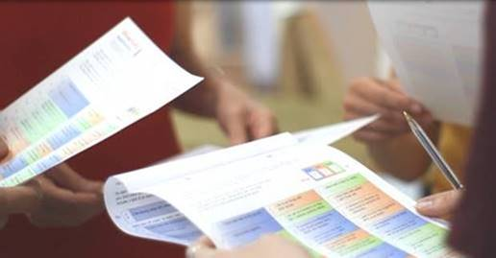
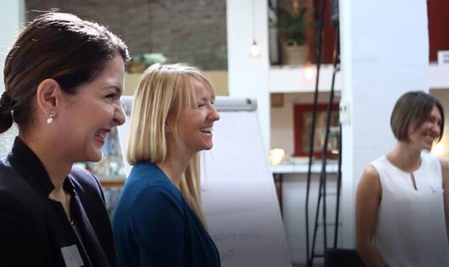
Questionnaire + Workshop

Slide 8
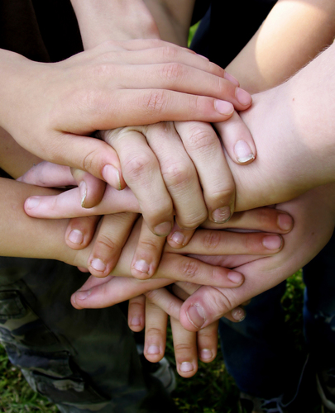
GREEN
RED
BLUE
Rhoda Davidson, IMD, 2006

Slide 9
Introduction to the workshop
Diversity Icebreaker is a process where you learn about yourself, the others and the other’s view of you
Four-steps:
Filling in and scoring the questionnaire
1.
Group tasks
2.
Group presentations
3.
4.
What can we learn from this?

Slide 10
Stage 1: Filling in the questionnaire
Any combination is possible as long as it adds up to a total of 6:
6-0-0
5-1-0
4-2-0
4-1-1
3-2-1
2-2-2

Slide 11
Stage 1: Scoring the questionnaire
Count all ticks in the blue cells and write the number next to blue and on the first page
Do the same with Red and Green
The total score of Blue + Red + Green=84
35
25
24

Slide 12
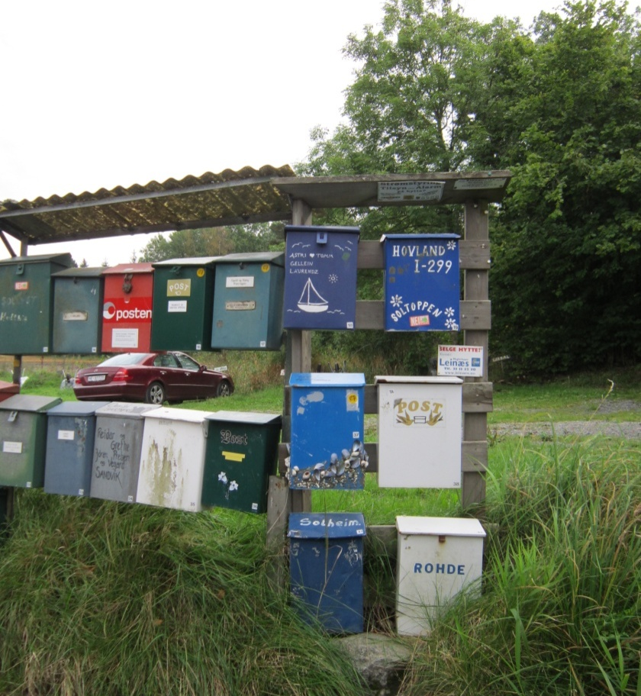
Stage 2: Group tasks
What are the great qualities of people of your own color in interaction with others?
How do you describe the people of two other colours (separately)?

Slide 13
Stage 2: Group tasks
What are the positive qualities of people of your own color in interaction with others?
How do you describe the people of two other colours? (One colour per page!)

Slide 14
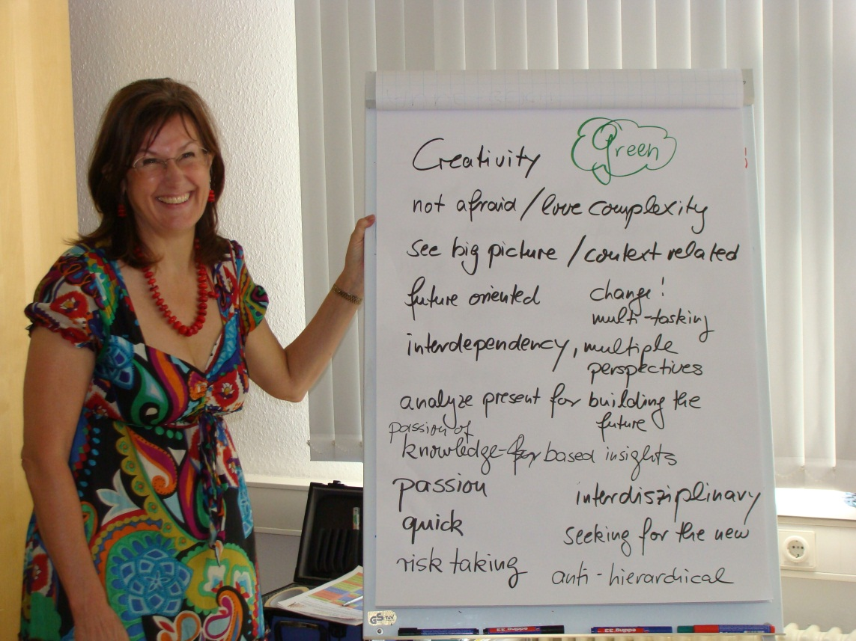
Stage 3: Group presentations
What have you written about people of your own colour group?
What have the people of two other colours written about you?

Slide 15
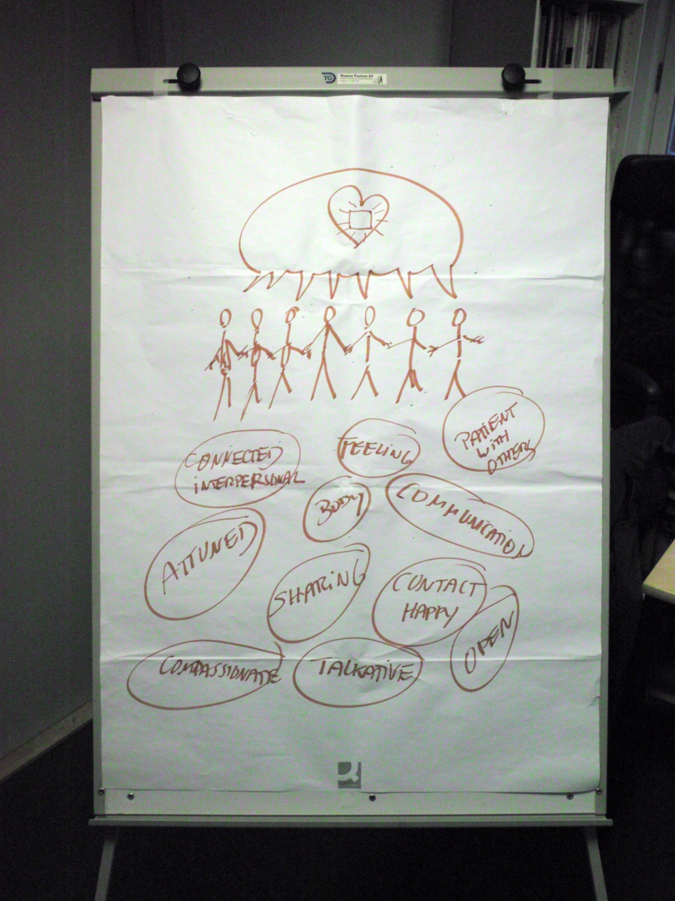

Slide 16
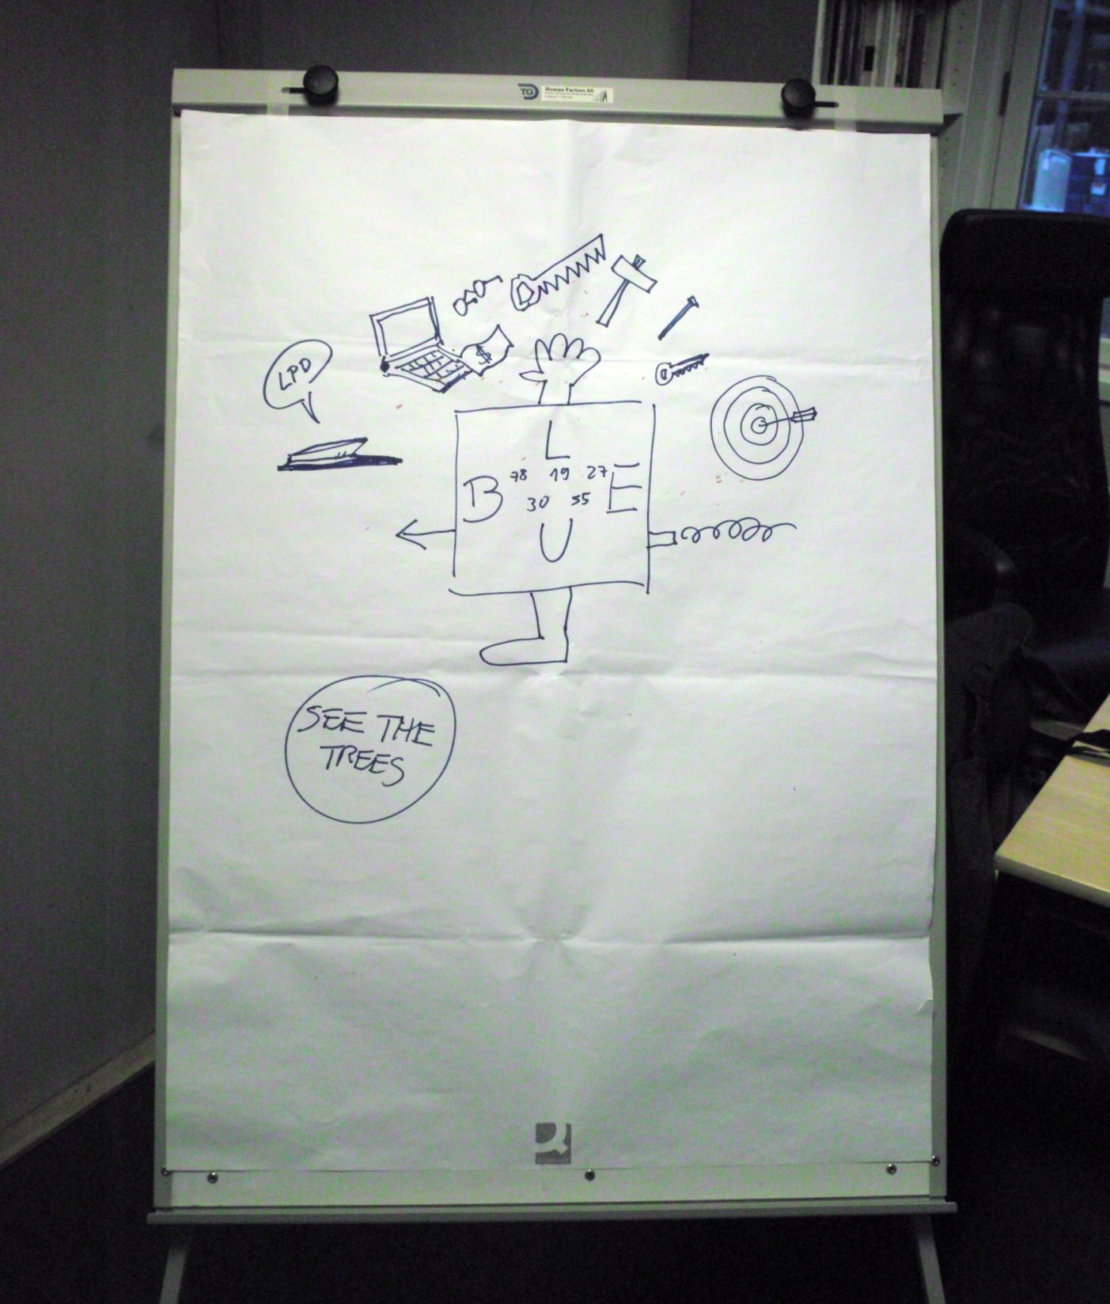

Slide 17
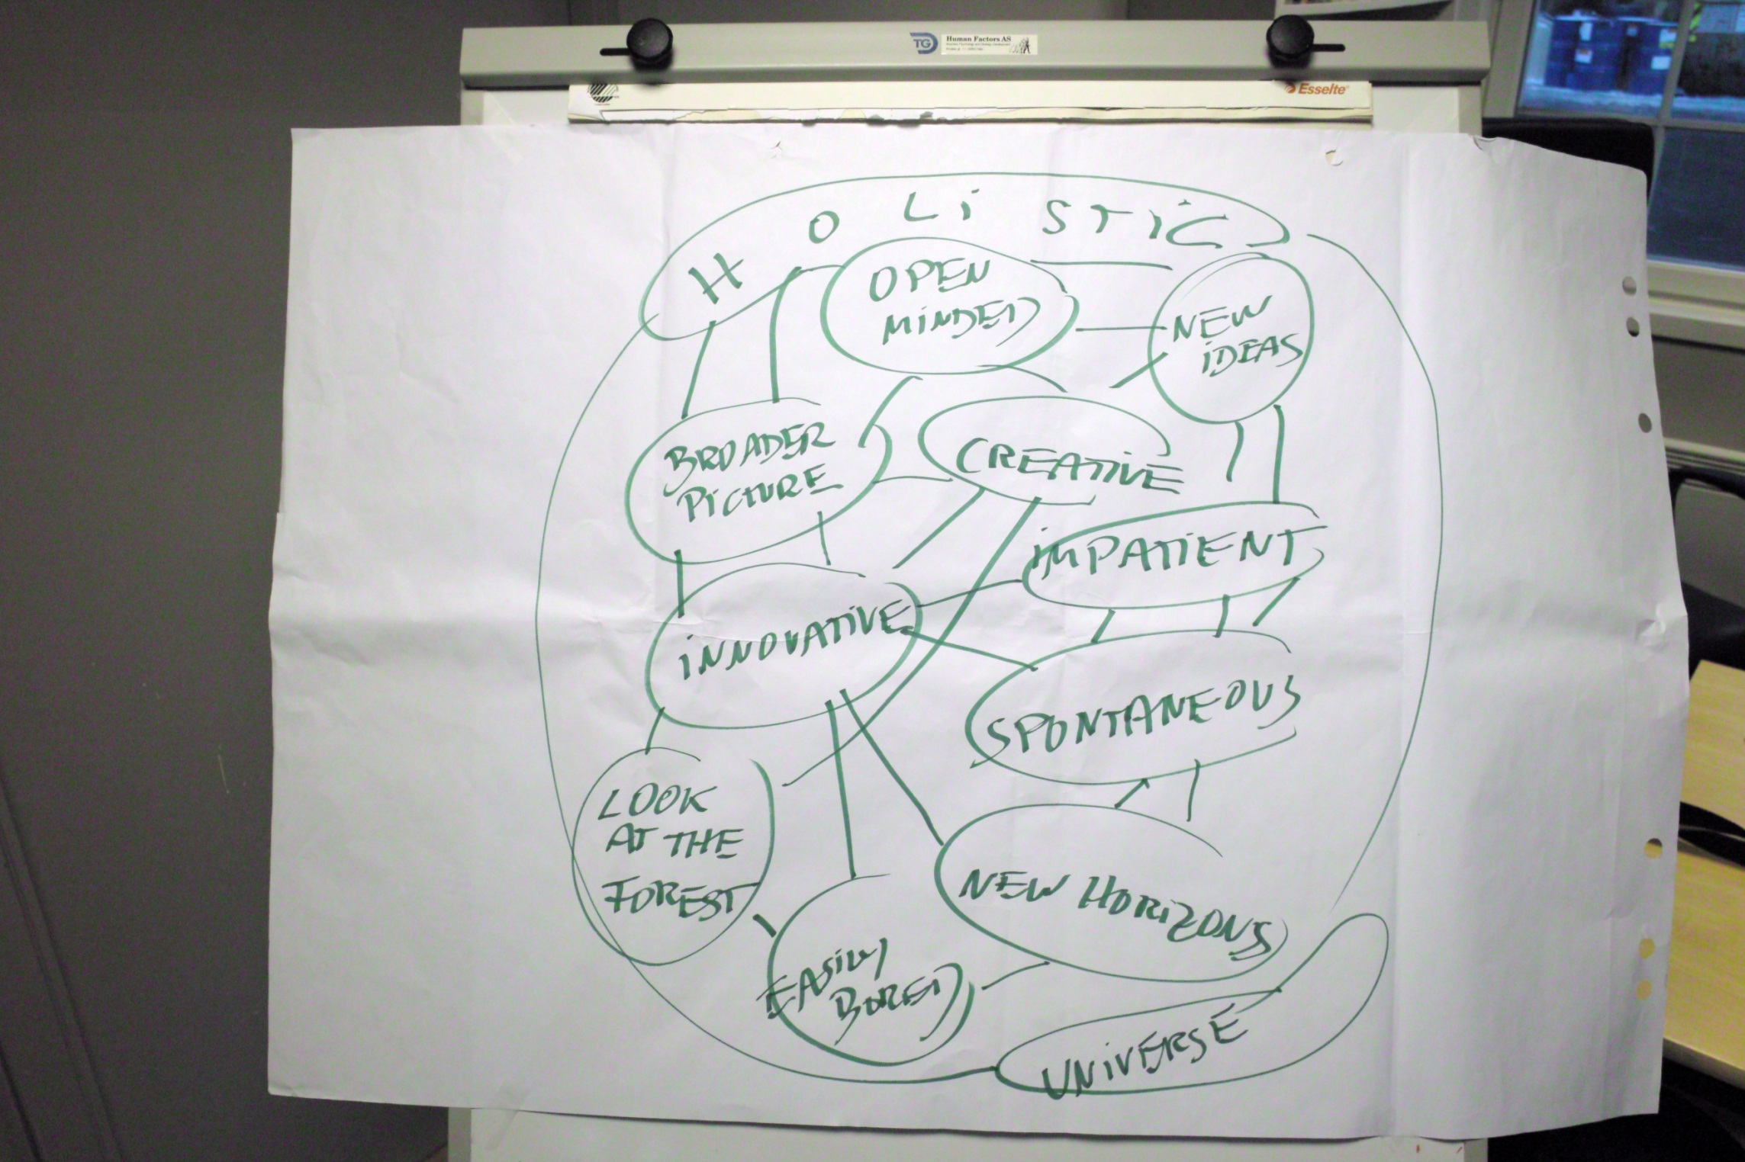

Slide 18
Stage 4: What have we learned from this?
Positive expectations of good dialogues.
One can contribute differently in different stages of the process.
We better understood the group dynamics.
We have created our own language.
It’s OK to be different if uniqueness is perceived positively by others.
No uniqueness is better and more powerful than another.
Categories are complementary and egalitarian.
Your difference
is my challenge.
People are different, in different situations.

Slide 19
Team Role, personal differences relevant for
BLUE:
be down-to-earth,
logical, practical, focus
on details, use facts and
examples, be structured
and well prepared, goal
oriented
GREEN:
focus on the larger
picture give time for
reflection, be positive
to change and creative
ideas, set high goals,
be value oriented
RED:
use conversation, harmonious discussion be personal, show trust, be enthustiastic, focus on social consequences and community spirit
Interaction and
distribution of tasks:

Slide 20
Combining the individual and generic perspectives
Plan
Facts
Focus
Logic
Structure
People
Empathy
Care
Harmony
Inclusion
Purpose
Opportunity
Ideas
Courage
Independent
Predictability
Plans
Milestones
Structure
Responsibilities
Control
Involvement
Influence
Coping
Community
Meaning
Vision
Sense
Effect
Rationale
Notes:
A very simple model of describing key personality characteristics

Slide 21
DI-workshop: creation of meaning
Positivistic test psychology tradition
Social construction of meaning in workshops
Personality:
Extroversion
Agreebleness
Conscientiousness
Openess
Social world, agreement
Values:
Benevolence
Universalism
Tradition
Security
Conformity
Power
Self-direction
Hedonism
Stimulation
DI model:
Red, Blue and Green
Workshop: Meaning of the Categories
Objectifyng
Real world input
Cognitive styles
Analytical/sequential
Hollistic/connective
Personal experiences

Slide 22
Summary
Change is part of our life
We are good at adapting when we have to
Leading and managing effectively through change is challenging, but can be managed more effectively through increasing:
Predictability (plans and processes)
Perceived control (people)
Meaning (purpose and direction)
Notes:
Take responsibility and act! Thinking is not acting
Good luck. I know you are capable and can do it!

Slide 23
«Reframing Others into categories of Mastery»
Meeting strangers kicks uncertainty/fight/flight – but by reframing the Others inside a system of mastery, Red, Blue and Green, - the meeting with the Other’s turn into a meeting with a person that one knows how to approach. It is a perceptual reorganisation that triggers other scripts where oneself and the other has a shared belief of mastery

Slide 24
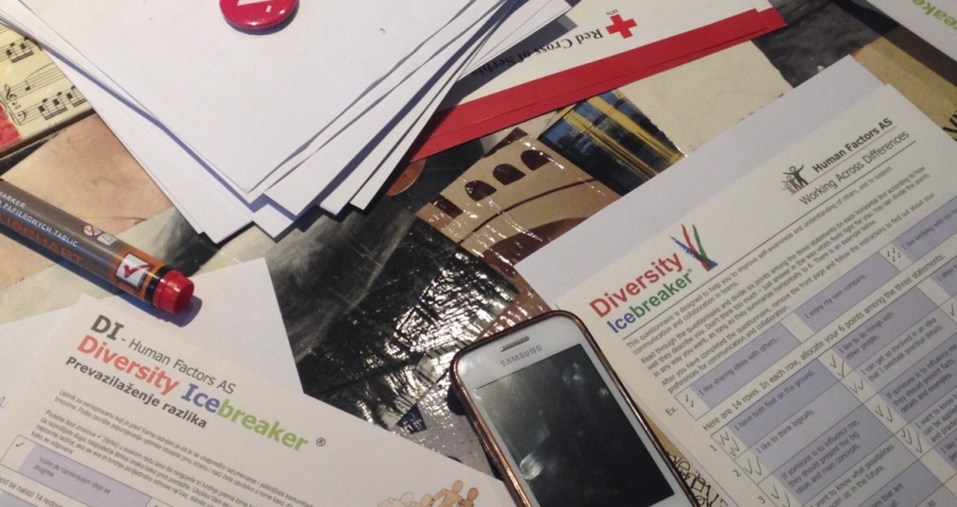
Working with the Red Cross Diversity Icebreaker Virtuous cycle Ivana Petrovic
engage with others
emotionally
☺
helping behaviors
make us all happier

Slide 25
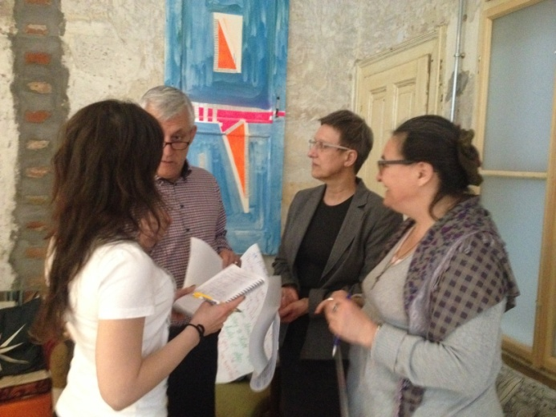
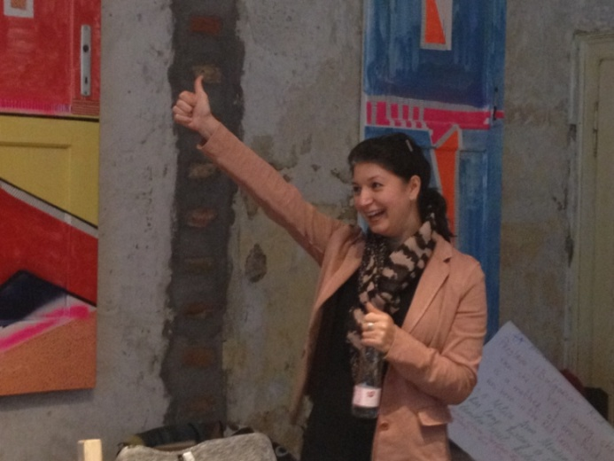
IFRC Europe zone
Project: Protect Humanity
Communications meeting, May 3-5, 2016
Fundraising conference, June 22-24, 2016
Participants – RC secretaries, communications, fundraising and advocacy staff from more than 30 countries
DI + Storytelling

Slide 26
Diversity Icebreaker Virtuous cycle
engage with others emotionally
helping behaviors
make us all happier
☺

Slide 27
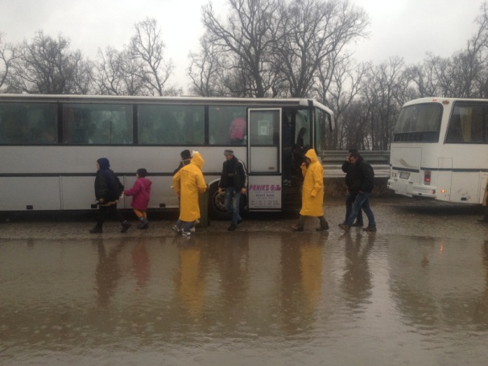
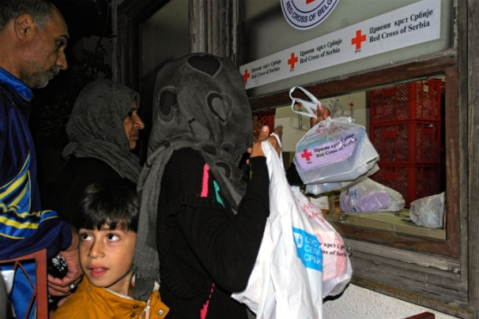
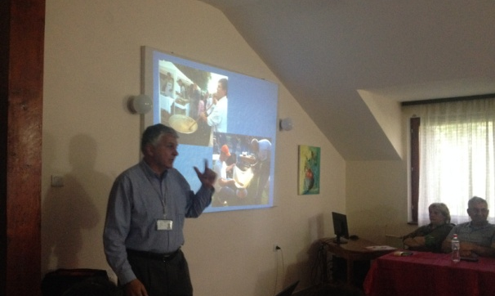
Red Cross of Serbia
Project: Communications capacity building in Serbia
Set of trainings across the Serbia
Humanity in Communication
Participants
RC employees – branch secretaries, project managers
RC volunteers
Journalists
Topics
Communicating with the media
Storytelling in crisis communications
Photography
Job demands – resources model (Bakker and colleagues) and stress prevention and relief

Slide 28
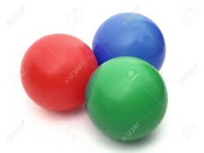
Tell a story about migrants
Humanost u komunikaciji
Groupwork
Single color groups 5‘
Mixed color groups 25'

Slide 29
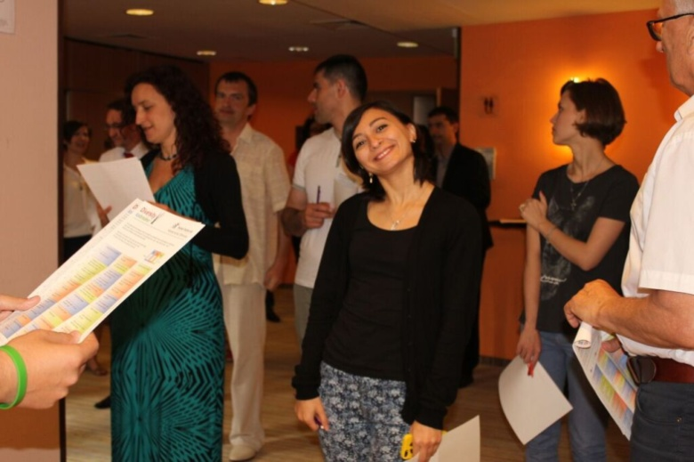
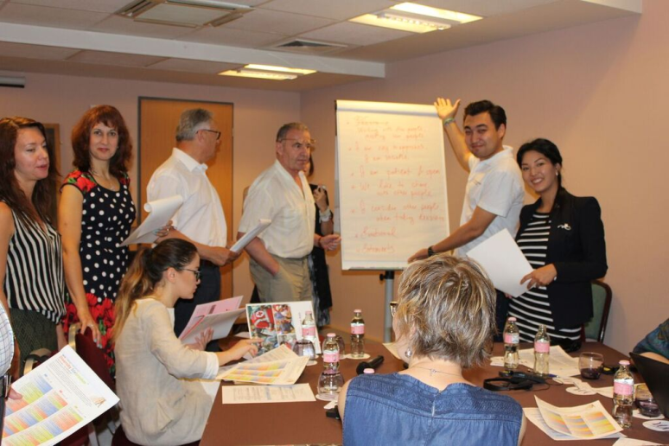
IFRC Europe zone
Fundraising conference, June 22-24, 2016
50 participants from Albania, Armenia, Austria, Azerbaijan, Belarus, Belgium, Bosnia, UK, Bulgaria, Croatia, Check R., Denmark, Finland, Georgia, Germany, Hungary, Kazakhstan, Kyrgyzstan, Lithuania, Macedonia, Moldova, Montenegro, Netherlands, Poland, Russia, Serbia, Slovakia, Slovenia, Sweden, Switzerland, Tajikistan, Turkey, Turkmenistan, Ukraine, Uzbekistan, Canada
Working languages – English and Russian
Exchange of experience, presentations of cases, corporate perspective…
DI & storytelling

Slide 30
Storytelling workshop
Повествование мастерская
3 groups
Mixed colors
Смешанные цветы
Prepare a story that you could use for fundraising
E-mail
F2F
Website
Video
…

Slide 31
IFRC: Space for DI
Audiences & occasions
Thematic issues
Employees
Volunteers
Experts working for RC (missions, assignments, consulting)
Beneficiaries (refugeers, migrants, dissaster victims, victims of domestic violence…)
Decision makers – state, experts, international organizations, donors, corporate partners, communities
Cross-organizational teams
Problem solving groups
Virtual teams
Participants at meetings and events (statutory mtgs, regional, forums, conferences)
…
Health
Migration
Disaster management, disaster relief -working with beneficiaries, team building for dssaster relief teams, disaster risk reduction
Social inclusion
Humanitarian education, educational programs
Water, sanitation and hygiene
Shelters
Livelihoods
Nonviolence and peace
Communications, advocacy, fundraising, strategic partnerships - influencing and leading
Organization, strenghtening capacities of NS, organizational development, change, internal communications, teamwork, coaching staff, staff stress relief
…

Slide 32
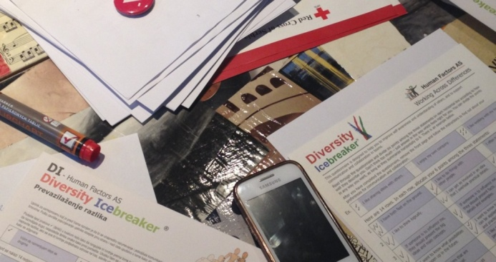
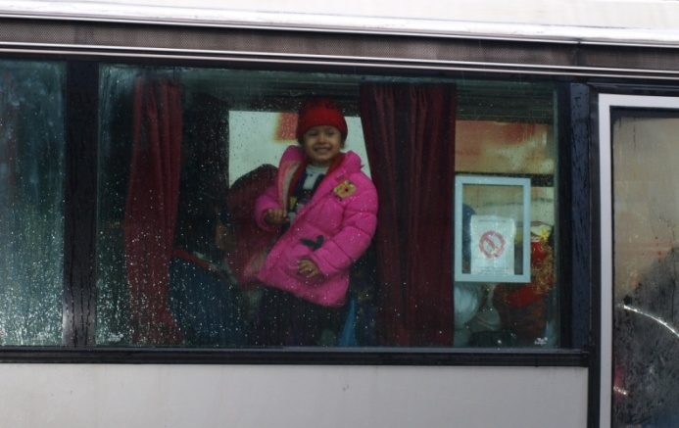
engage with others emotionally
engage with others
emotionally
helping behaviors
make us all happier
☺

Slide 33
2015 - People on the move
IFRC Annual Report 2015 http://www.ifrc.org/Global/Documents/Secretariat/201610/IFRC%20Annual%20Report%202015-EN_LR.pdf

Slide 34
Anne Brulez, Germany - Greece
My Job should be to work with the staff and the volunteers. With the stuff I could not work with the DI because, they were all very stressed and working always like a firemen. My first workshop with them started 1 hour late and when they were sitting in the room the one that was responsible for the kids ran out of the room, because the kids were making a lot of noise and bumping at the door and the psychologist ran out because a pregnent refugee had to go to the hospital, and then the translator ran out...
The second workshop we used the DI and it was helpful to see why the Red the Blue and Green were acting different with the stress and the frustrations by not being supported well. We also started discussions about the culture differences of the mostly syrian refugees, they asked themselves why the refugees only waited to go further to Germany, nobody wanted to stay in Greece.
With this group it was helpful and gave them and orientation in their work.

Slide 35
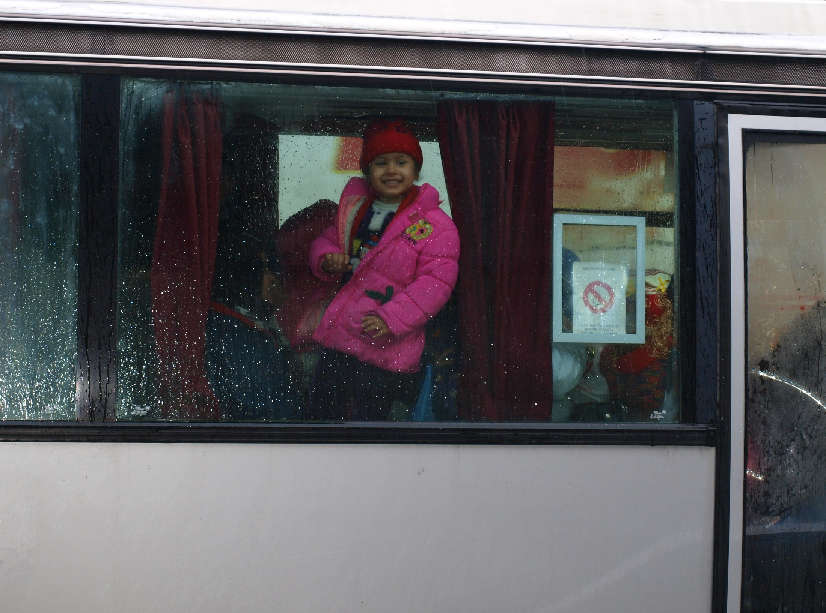

Slide 36
Dina Gericke, Hoch Schule Bremen
Car manufactor: 15 Refugees – 15 vocational students, mentoring, …a few statistically significant changes among the refugee group and the group of vocational students. Changes showed on the affect scales we used as well as on the scales asking about values and future expectations.
Publishing company: With this group og 8 refugees and 8 vocational students we have the opportunity to collect data over a longer period of time. They filled out the first questionnaire in July and they will fill out the second round of questionnaires later this year. Additionally we are able to interview the refugees to gain a more in-depth perspective on their experiences, half of the interviews I have already conducted at this point.
Just two weeks ago I conducted the Diversity Icebreaker with the group of refugees at the Publishing Company and they really liked it. The program manager said to me that they still use the color system as a basis for their conversations.

Slide 37
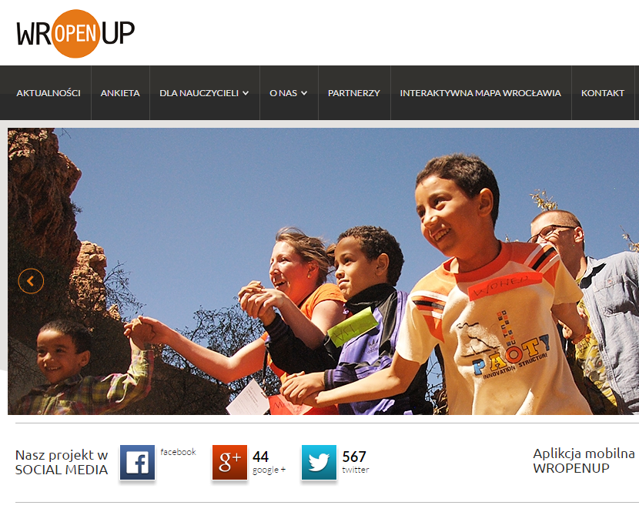
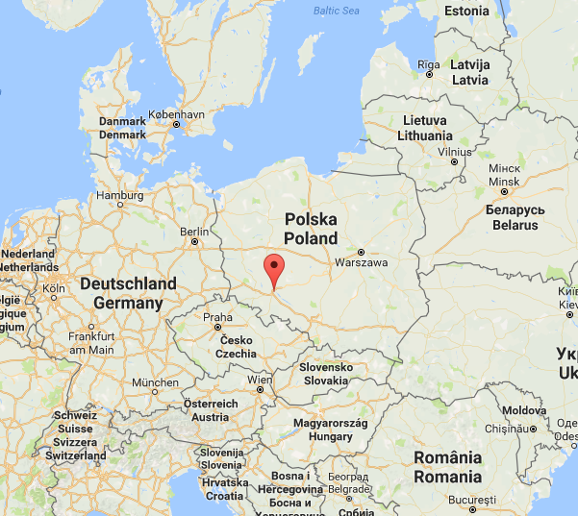
Poland – WrOpenUp-project
WrOpenUp’s mission:
educate young people about diversity; create future ambassadors and socially engaged leaders who respect, use and promote diversity in their communities
provide young people “competencies of the future”, e.g. related to cooperation in virtual and cross-cultural teams

Slide 38
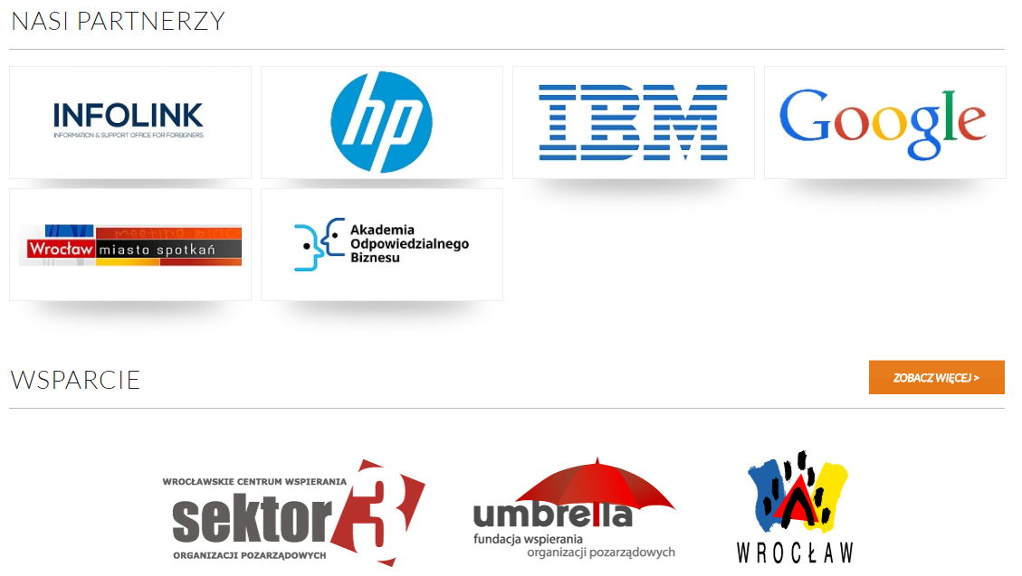
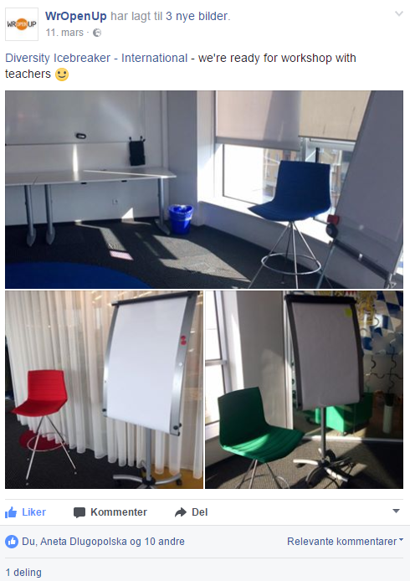
WrOpenUp & DI/Trialogue
project train 300 teachers in using the tool, create lesson plans and follow-up tools they will be able to use with students

Slide 39
Right at the beginning of the workshop the "DI" helped the teachers to overcome personal restraints and suspicions. The «DI»created a different sense of belonging among the participants, dividing them into colors rather than into nationalities. Thus the issue of being Israeli, Palestinian or Jordanian took a seat back and left enough room for the teachers to integrate into new groups, independently on their national identity.
What Mr. Bjørn Ekelund called the creation of a "third culture" highly contributed to the positive atmosphere of the workshop and the big "elephant" inside the room - the Israeli-Arab conflict - became almost invisible. This was the 6th teachers' workshop I have lead since 2007, and I can say it was the most successful one. I have no doubt that the DI made an important contribution to its success by helping the teachers to think "out of the box" and to focus on the workshop's important issues rather than on the Middle East Conflict.»
Annika Khano Konrad-Adenauer-Stiftung e.V

Slide 40
Our assumption on trust development Middle East
following DI seminar in conflict resolution From Sietar paper 2013
Reduced time in risk zone
Trust
Value of DI
Time

Slide 41
Trust building components in the DI seminar
From Sietar paper 2013
6. Continuity: Trust due to Predictability
Acknowledgement
Postive Affect / Humor
Egalitarian model / Balanced power
Social Diclosure – Probing
Integration in a small and large group
7. Likeability, across diversity
8. Shared mental models of functional interaction
9. Freedom from distrustful behavior like; Lying, cheating, hidden agenda, threatening, offensive, self-detrimental, non-dignified behaviors

Slide 42
Norway
Fast track introduction program
https://youtu.be/IGeFaYlCAhI

Slide 43
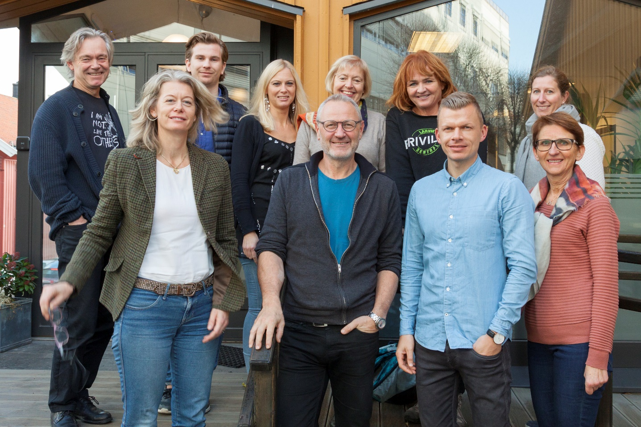
Larvik 2017-2018: Housing for Norwegian and immigrant families who cannot afford
a decent house.
Theory U + Diversity Icebreaker, 6 months process
Prototyping collective preparations.
Involved partners: Husbanken, University College SoutEast, Larvik Municipality

Slide 44
Learning relevant for practice
Complexity in the situation needs more preparation, Diversity Icebreaker should be integrated in a long term planned process of change.
Use more time in the scoring and exploring process during the seminar.

Slide 45
Theoretical and resarch questions
Reframing processes – possibilities and limits
Common ground -
What promotes?
Qualities of common ground?
Minimum needed for exploring differences?

Slide 46
Behind the Diversity Icebreaker Human Factors AS
Thank you very much for your attention.
Diversity
Icebreaker
Network
on LinkedIn
Diversity
Icebreaker –
International
on Facebook
Notes:
Note: link to the Human Factors AS website is under the HF logo in the right-down corner; link to the DI homepage is under the logo in the left-down corner Both LinkedIn and Facebook logos link to relevant social network pages.

