Slide 1
Employee expectations of psychological safety
An Investigation in two Norwegian organizational settings
JAKE LIVINGSTONE, EMILY DUGAL
MAHSHID SOLEIMANI, TAYLOR RYAN
BRYNN BONDY, FABIHA TAHSIN
NADA HUSSEIN, CATHERINE T. KWANTES
University of Windsor
BJØRN Z. EKELUND
Human Factors Norway

Slide 2
Background
Employee experiences are different from organization to organization (e.g. nature of work, different management approaches, differing organizational cultures)
Literature suggests that occupation is related to organizational culture preferences (Kwantes & Bolgarsky, 2004)
Further, organizational sector can impact organizational culture (Phillips, 1994)

Slide 3
Research question
Psychological safety often described as a “climate of psychological safety”
So then, if organizational culture and climate preferences can differ with respect to occupation, might there be differences in what aspects of psychological safety are most important?

Slide 4
methodology
Transcripts from two focus groups conducted in Norway were analyzed.
Focus groups were conducted in Norwegian, and transcripts translated into English by a bilingual speaker
Focus groups were formed after an organizational development intervention aimed at creating greater inclusivity and safety in the workplace

Slide 5
Diversity icebreaker (Ekelund, 1997)
Focus group participants came from organizations that had used the Diversity Icebreaker concept in multiple settings, in many years.
Discussion focused on gaining an understanding of how lessons learned in the workshops were implemented
What was integrated in practice in the months and years following multiple seminars.
Notes:
The Diversity Icebreaker questionnaire and workshop were developed in Norway between 1995-1997 by psychologist Bjørn Z. Ekelund and his company, Human Factors AS.
In this research we decided to interview and do focus groups in organizations that had used the Diversity Icebreaker concept in multiple settings, in many years. We wanted to search for an understanding of implemented practice – not immediate comments and ideas concerning the Diversiity Icebreaker seminar per se. We searched for what has been integrated in practice, behaviourally and communicative, in the months and years following multiple seminars.

Slide 6
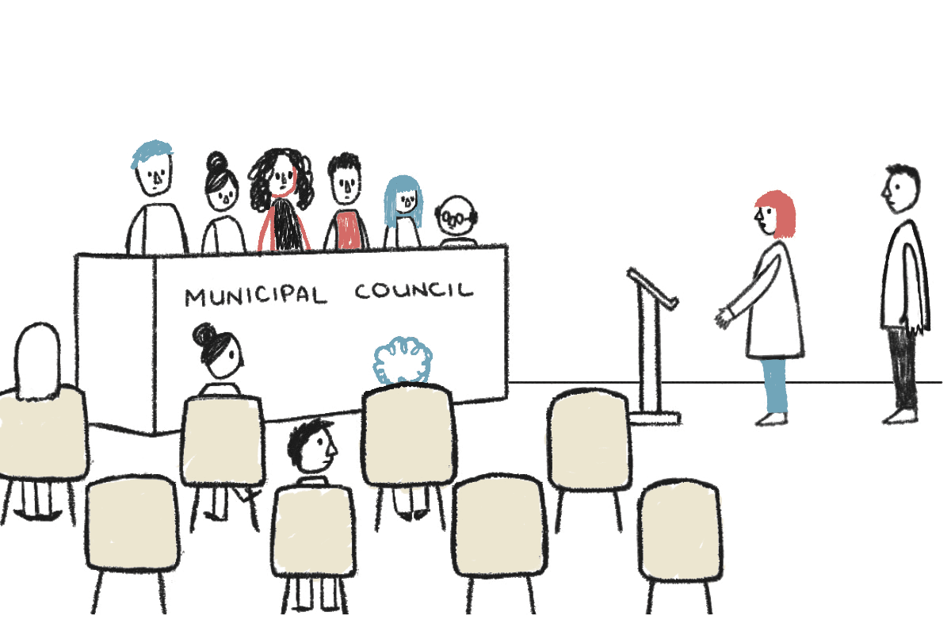
Methodology: Diversity Icebreaker workshop
Focus groups from two occupational sectors:
Aspects of organizational culture may differ depending on sector within which an organization functions (Howard, 1998)
Healthcare sector – characterized by multiple subcultures, often competing interests (Mannion & Davies, 2018)
Municipality sector – emphasis on rationality, formalized decision-making, structure (Parker & Bradley, 2000).
Notes:
NOTE: Hospital sector, not Hospitality as indicated in the program….
Mannion, R., & Davies, H. (2018). Understanding organizational culture for healthcare quality improvement. The BMJ, 363. CCBYNC Open access
doi: https://doi.org/10.1136/bmj.k4907 (Published 28 November 2018)
Cite this as: BMJ 2018;363:k4907
Howard, L.W. (1998). Validating the competing values model as a representation of organisational cultures. International Journal of Organizational Analysis, 9(3), 231-250.
Machen, S., Jani, Y., Turner, S., Marshall, M., & Fulop, N. J. (2019). The role of organizational and professional cultures in medication safety: a scoping review of the literature. International Journal for Quality in Health Care, 31(10), G146–G157
Mrkonjić, R., Ristić, J., Jambrović, I., Rukavina, M., & Rašić, I. (2019). Analysis of the organisational culture in two Croatian hospitals. British Journal of Nursing, 28(10), 647–651
Parker, R., & Bradley, L. (2000). Organisational culture in the public sector: evidence from six organisations. International Journal of Public Sector Management, 13(2), 125.

Slide 7
Thematic coding
Codebook developed based on definitions of psychological safety in the literature.
Four trained coders developed a codebook of
Thematic categories
Themes
Linguistic Markers
Codebook then applied to transcripts by three trained coders

Slide 8
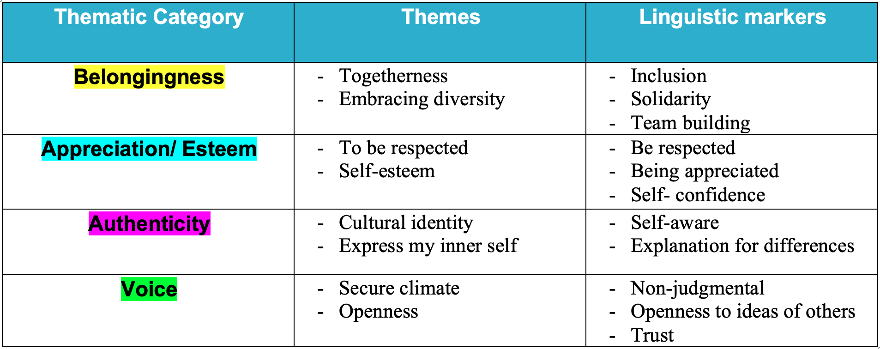
Psychological safety codebook

Slide 9
Results
Health sector
Municipality
Rank | Theme
1 | Belongingness
2 | Voice
3 | Authenticity
4 | Appreciation/Esteem
Rank | Theme
1 | Belongingness
2 | Voice
3 | Authenticity
4 | Appreciation/Esteem

Slide 10
Discussion
Rank ordering of number of times each theme was mentioned was identical in both organizations
Assumption is that this reflects degree of importance of each theme with respect to how inclusion and safety lessons can and should be applied within organizations
Unlike much of the literature in North American culture which emphasizes the role of voice (for example, O’Donovan & McAuliffe, 2020), belongingness seemed to be more important in these contexts
Notes:
O’Donovan, R., & McAuliffe, E. (2020). A systematic review exploring the content and outcomes of interventions to improve psychological safety, speaking up and voice behaviour. BMC Health Services Research, 20(1), 1–11.
NOTE: In a systematic review of the psychological safety literature in 2017 (Newman et al), belongingness was not even mentioned as an outcome, although voice was….

Slide 11
Limitations
The coding used in the project was based on an individual level of definition.
Focus groups discussion revolved around applying workshop activities and results to the workplace.
Notes:
The coding used in the project was based on an individual level of definition. – YET the discussants were talking about group level outcomes – this has been an issue in much of the PS literature, and there is no reason to assume that the construct is NOT isomorphic at different levels, but this project did not explicitly tease that apart.
Focus groups discussion revolved around applying workshop activities and results to the workplace – so the discussions were not explicitly about psychological safety, but we could look at psychological safety dimensions in the discussions by examining the themes that arose in the discussions.

Slide 12
Future Research
Expand the investigation of what aspects of psychological safety may be more important in various occupations
Current research focussed on organizations in two different sectors
Future research could focus on individuals in different occupations as values and preferences may impact occupational choices (Persson et al, 2001)
Investigate the impact societal culture may have on employee preference for various aspects of psychological safety
Not all cultural value systems prioritize “voice” for example (Kwon & Farndale, 2020)
Notes:
Persson et al (2001) Value Dimensions, Meaning, and Complexity in Human Occupation: A Tentative Structure for analysis., Scandinavian Journal of Occupational Theraply, 8(1), 7-18.

